Slide 1
CSE514 – Datamining Fall 2022 Artificial Neural Networks
Cynthia Ma
Department of Computer Science
Washington University in St. Louis
czma@wustl.edu

Slide 2
Quick admin follow-up
Homework 1
Grades are out on Gradescope for on time submissions
Canvas grades are more likely out of date
Regrade requests are open from 4pm today to midnight next Tuesday
Late penalties are not yet applied

Slide 3
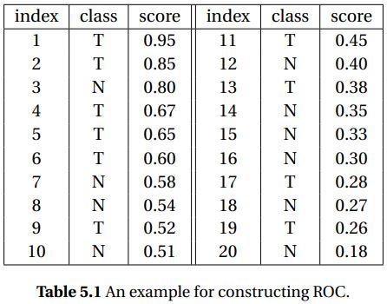
ROC and PR curve example

Slide 4
What is an artificial neural network?
A model comprised of connected layers of nodes
…
…
…
…
Input layer
Output layer
Hidden layers

Slide 5
Component details
Input nodes: predictor variable values
Edges: for incoming node value x
outgoing node gets weight*x
Hidden layer nodes: transforms incoming values with an activation function and a bias term
Output nodes: may have an additional function
before final model prediction

Slide 6
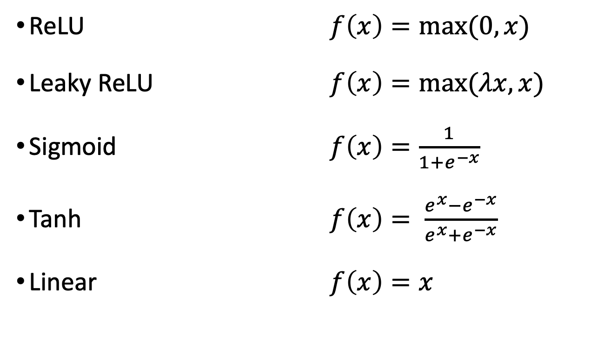
Activation functions
ReLU $f\left(x\right)=max⁡(0,x)$
Leaky ReLU $f\left(x\right)=max⁡(λx,x)$
Sigmoid $f\left(x\right)=\frac{1}{1+e^{−x}}$
Tanh $f\left(x\right)= \frac{e^{x}−e^{−x}}{e^{x}+e^{−x}}$
Linear $f\left(x\right)=x$

Slide 7
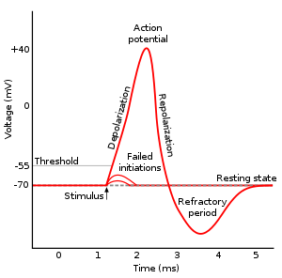
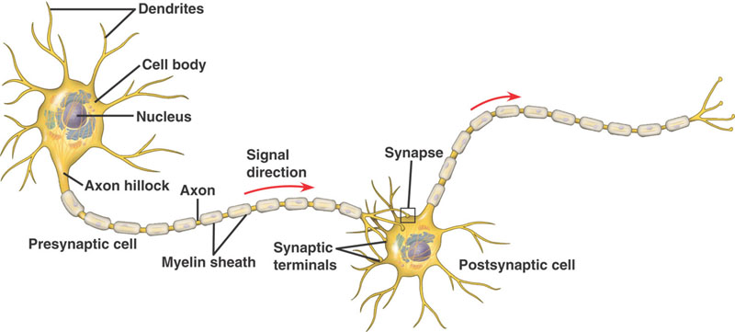
Biological parallel
Action potentials
Inter-neuron connections

Slide 8
Choosing an Activation Function
Range of activation
Are there limits to the output values?
Does it have negative output? Is it zero centered?
Can it model non-linear behavior?
Derivative for parameter optimization
Do the input values matter?
Computational cost

Slide 9
Named problems
Dying ReLu: for activations of the x < 0 region of ReLU, the gradient will be 0 and the weights will not be adjusted
Vanishing gradient problem: the limited range of Sigmoid and Tanh derivatives results in dramatically decreased error being back-propagated through deep networks
Exploding gradient problem: when activation functions with large derivatives are used

Slide 10
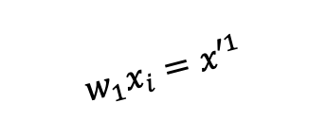
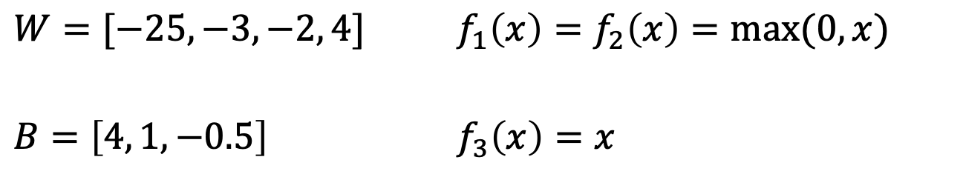
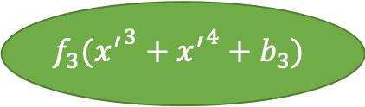
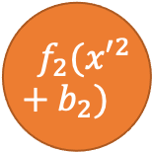
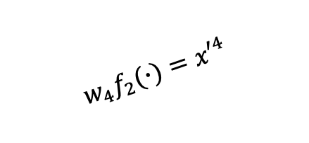

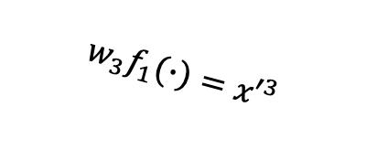
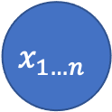
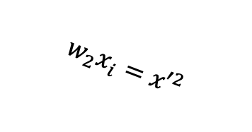
Using a “trained” ANN
$${ f}_{1}({x′}^{1}+b_{1})$$
$$w_{1}x_{i}={x′}^{1}$$
$$w_{3}f_{1}(∙)={x′}^{3}$$
$$x_{1…n}$$
$$f_{3}({x^{′}}^{3}+{x^{′}}^{4}+b_{3})$$
$$w_{2}x_{i}={x′}^{2}$$
$${ f}_{2}({x′}^{2}+b_{2})$$
$$w_{4}f_{2}(∙)={x′}^{4}$$
$W=[−25, −3, −2, 4]$ $f_{1}\left(x\right)=f_{2}\left(x\right)=max⁡(0,x)$
$B=\left[4, 1, −0.5\right]$ $f_{3}\left(x\right)=x$
Notes:
병찬, x = 2 라면
x’1 = -25 * 2 = -50
x’2 = -3 * 2 = -6
f1(-50 + 4) = max(0, -46) = 0
f2(-6 + 1) = max(0, -5) = 0
x’3 = -2 * 0 = 0
x’4 = 4 * 0 = 0
F3(0 + 0 + -0.5) = -0.5
병찬, input = -2 라면
X’1 = -25 * -2 = 50
X’2 = -3 * -2 = 6
F1(50 + 4) = max(0, 54) = 54
F2(6 + 1) = max(0,7) = 7
X’3 = -2 * 54 = -108
X’4 = 4 * 7 = 28
F3(-108 + 28 + -0.5) = -80.5

Slide 11
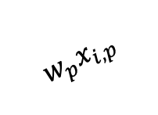

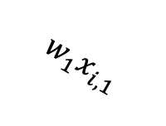



Additional ANN terminology
$$x_{i,1}$$
$$w_{1}x_{i,1}$$
$$x_{i,2}$$
$$f(∙)$$
…
$$w_{p}x_{i,p}$$
Neurons = nodes
Perceptron: single node binary classifier
Architecture/Topology: number and organization of
nodes, layers, connectors
Propagation function: weights and biases applied from one node to the next
$$x_{i,p}$$

Slide 12
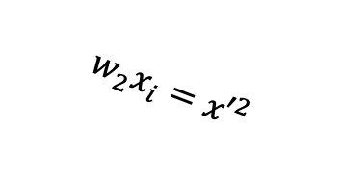

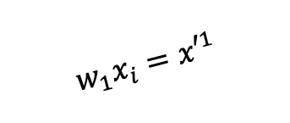
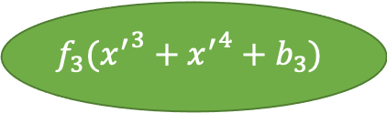

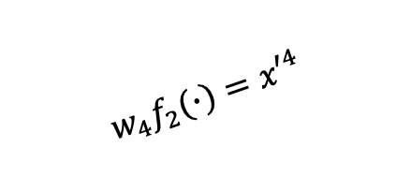

Backpropagation
ANNs are optimized w/ stochastic gradient descent
Remember GD for a linear model optimized w/MSE?
We can do the same for the last node of an ANN
How do we extend this to the parameters farther back?
Chain rule
$${ f}_{1}({x′}^{1}+b_{1})$$
$$w_{1}x_{i}={x′}^{1}$$
$$w_{3}f_{1}(∙)={x′}^{3}$$
$$x_{1…n}$$
$$f_{3}({x^{′}}^{3}+{x^{′}}^{4}+b_{3})$$
$$w_{2}x_{i}={x′}^{2}$$
$${ f}_{2}({x′}^{2}+b_{2})$$
$$w_{4}f_{2}(∙)={x′}^{4}$$

Slide 13
ANN classification
When would we need multiple output nodes?
…
…
…
…
Input layer
Output layer
Hidden layers

Slide 14
Interpreting the output
-1
Faculty
2.5
Graduate student
…
…
…
0
Undergraduate student
Input layer
Output layer
Hidden layers
ArgMax
Notes:
병찬: 보통은 최대값이 선택된다고 보면 된다.

Slide 15
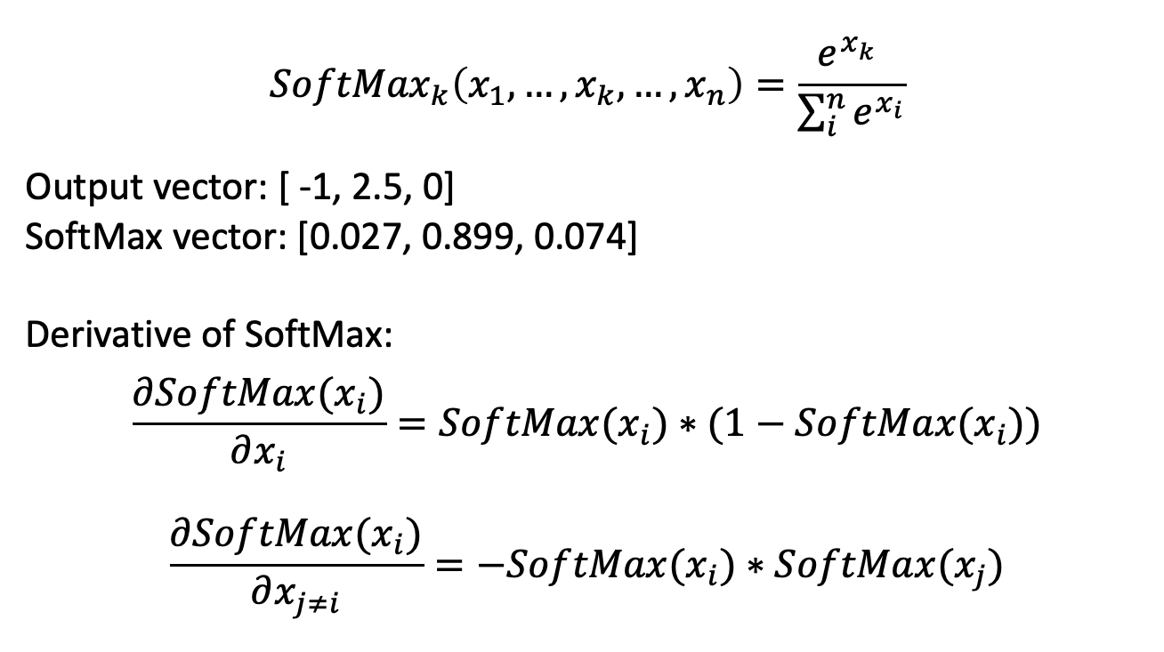
SoftMax output for classifiers
$${SoftMax}_{k}\left(x_{1},…,x_{k},…,x_{n}\right)=\frac{e^{x_{k}^{}}}{\sum_{i}^{n}{e^{x_{i}}}}$$
Output vector: [ -1, 2.5, 0]
SoftMax vector: [0.027, 0.899, 0.074]
Derivative of SoftMax:
$$\frac{∂SoftMax(x_{i})}{∂x_{i}}=SoftMax(x_{i})∗(1−SoftMax(x_{i}))$$
$$\frac{∂SoftMax(x_{i})}{∂x_{j≠i}}=−SoftMax(x_{i})∗SoftMax(x_{j})$$

Slide 16
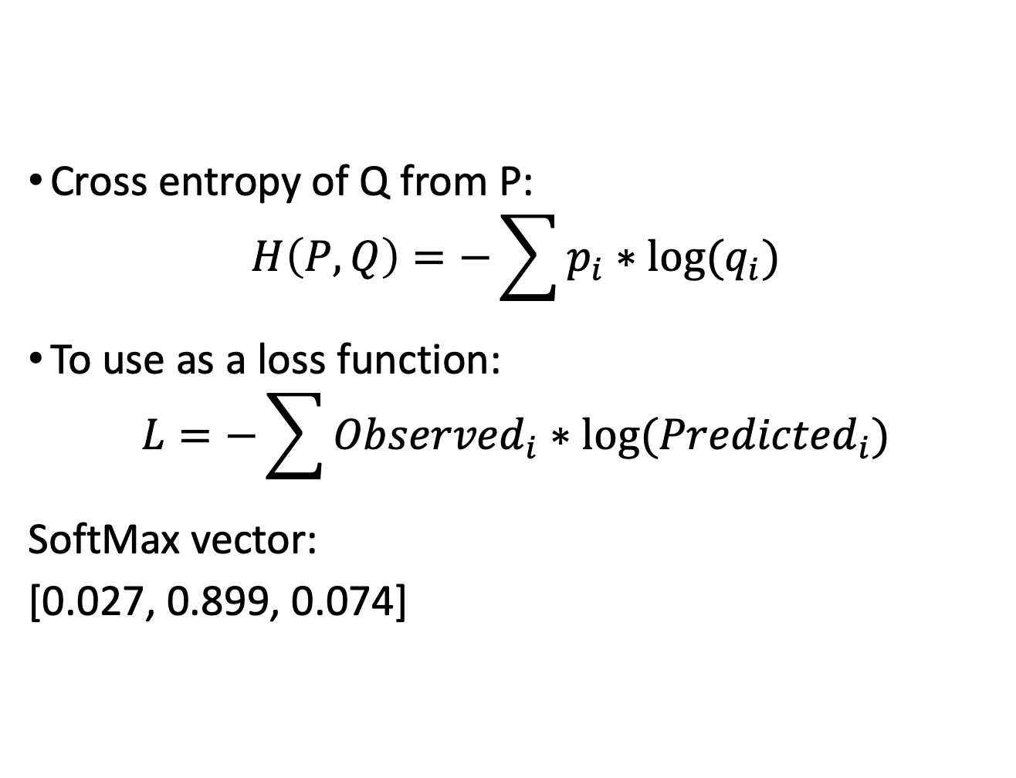
Cross entropy loss function
Cross entropy of Q from P:
$$H\left(P,Q\right)=−\sum{p_{i}∗log⁡(q_{i})}$$
To use as a loss function:
$$L=−\sum{{Observed}_{i}∗log⁡({Predicted}_{i})}$$
SoftMax vector:
[0.027, 0.899, 0.074]

Slide 17
Review
Artificial Neural Networks
Components
Activation functions
How to use
Biological parallel
ANN for classification
ArgMax vs. SoftMax output function
Cross-entropy loss

Slide 18
Homework
HW2 will be released at 4pm
Programming Assignment 1 due October 12

